Slide 1
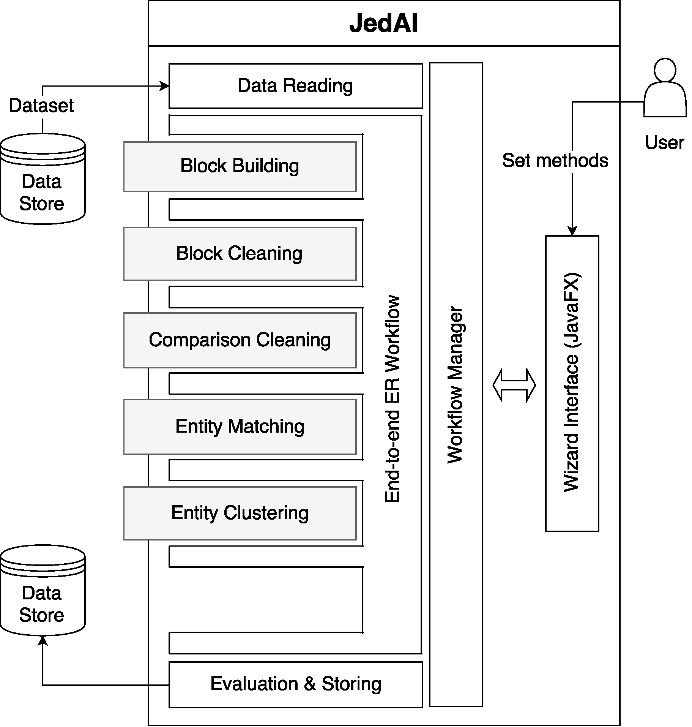
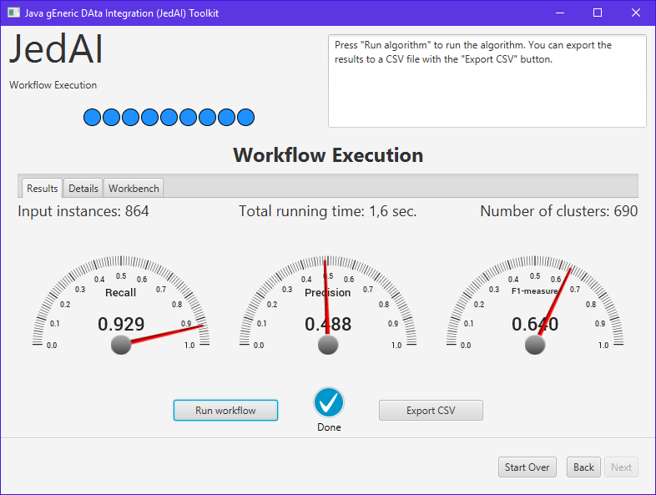
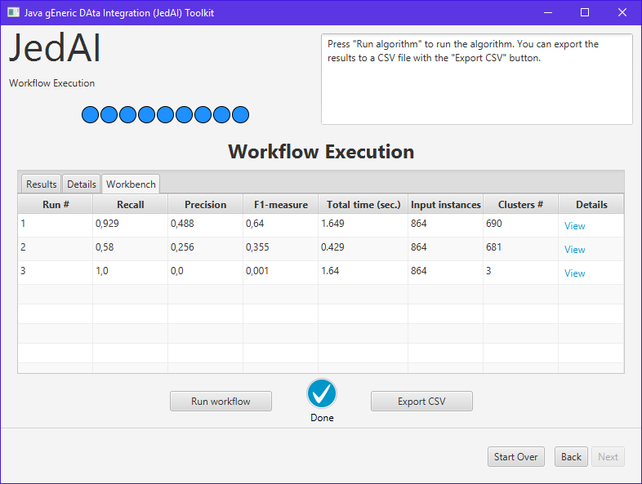





JedAI: The Force behind Entity Resolution
George Papadakis, Leonidas Tsekouras, Emmanouil Thanos, George Giannakopoulos, Themis Palpanas, Manolis Koubarakis
An open source library, desktop application and workbench for running and comparing the performance of state-of-the-art, out-of-the-box end-to-end ER workflows
Entity Resolution (ER)
Volume Challenge
Variety Challenge
Identifies and aggregates different entity profiles/records that describe the same real-world object.
Useful because:
Improves data quality and integrity
Fosters re-use of existing data sources
Application areas:
Linked Data, Social Networks, census data, price comparison portals, etc.
ER is an inherently quadratic problem: O(n²): every entity should be compared to all others → the brute-force approach does not scale to large the millions of entities and billion of triples in Linked Data
Solution: (Meta-)Blocking
group similar entities into blocks
execute comparisons only inside each block
refine initial blocks by removing repeated and superfluous comparisons
Linked Data involve extreme schema heterogeneity. E.g., out of the ~2,600 available vocabularies, only 109 are shared by at least two Knowledge Bases.
Solution: Schema-agnostic Functionality
all workflow steps are generic enough to disregard any schema information → no domain knowledge is required
the same workflow applies to relational data, as well
Step 1
Step 2
Step 3
Step 4
Step 5
Step 6
Step 7
Data Reading
Block
Building
Block
Cleaning
Comparison
Cleaning
Entity
Matching
Entity
Clustering
Evaluation & Storing
Reads files containing the entity profiles and the golden standard.
Supports any combination of CSV, RDF/XML, Relational DBs
Creates
overlapping blocks.
8 implemented methods.
Optional step that cleans blocks from useless comparisons.
3 (4) implemented complementary methods for Dirty (Clean-Clean) ER.
Optional step that operates on the level of individual comparisons to remove the useless ones.
7 implemented methods.
Executes all retained comparisons.
2 Matching methods with:
12 textual representation models
10 similarity measures
Partitions the similarity graph into equivalence clusters.
6 (1) implemented methods for Dirty (Clean-Clean) ER.
Stores and presents performance results.
Our advantages
Available (Meta-)Blocking Methods
JedAI covers both Dirty and Clean-Clean ER.
We can process both RDF and structured data (CSV, Relational DBs) in any combination.
Its methods are schema-agnostic, requiring no domain knowledge, and are associated with default configurations, requiring no manual fine-tuning.
We offer a GUI for lay users and a library with a well-defined API for power users that is extensible with new methods for any step.
JedAI offers workbench functionality, allowing the comparison of over 4,000 possible ER workflows.
Block Building | Block Cleaning | Comparison Cleaning
1. Token Blocking | 1. Block Filtering | 1. Comparison Propagation
2. Sorted Neighborhood | 2. Size-based Block Purging | 2. Cardinality Edge Pruning (CEP)
3. Extended Sorted Neighborhood | 3. Cardinality-based Block Purging | 3. Cardinality Node Pruning (CNP)
4. Attribute Clustering | 4. Block Scheduling | 4. Weighted Edge Pruning (WEP)
5. Q-Grams Blocking |  | 5. Weighted Node Pruning (WNP)
6. Extended Q-Grams Blocking |  | 6. Reciprocal CNP
7. Suffix Arrays |  | 7. Reciprocal WNP
8. Extended Suffix Arrays
Modular & Extensible architecture
Evaluate performance of results and export them to CSV
Workbench for comparing performance of multiple workflows
???
http://jedai.scify.org

